Slide 1
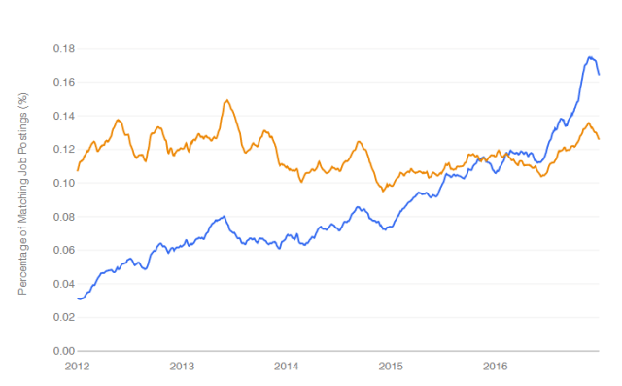
1.1 General introduction
Why ‘R’?
Data science job trends for R (blue) and SAS (orange).

Slide 2
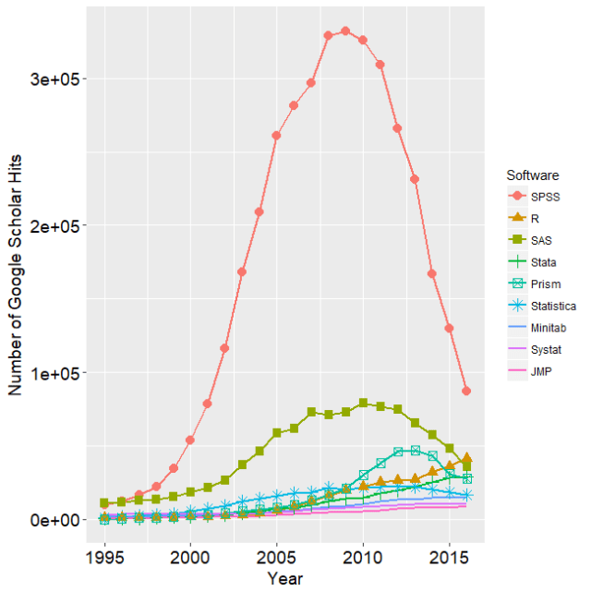
1.1 General introduction
Why ‘R’?
Number of scholarly articles published in the most recent complete year (2016) for the more popular data science software

Slide 3
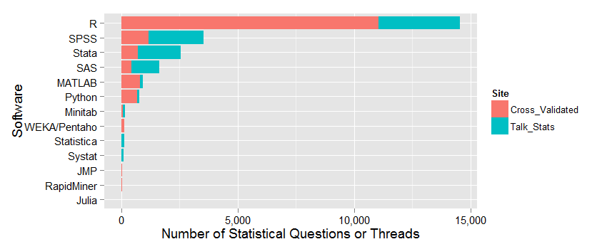
1.1 General introduction
Why ‘R’?
Number of questions and for each software on Talk Stats and Cross Validated.

Slide 4
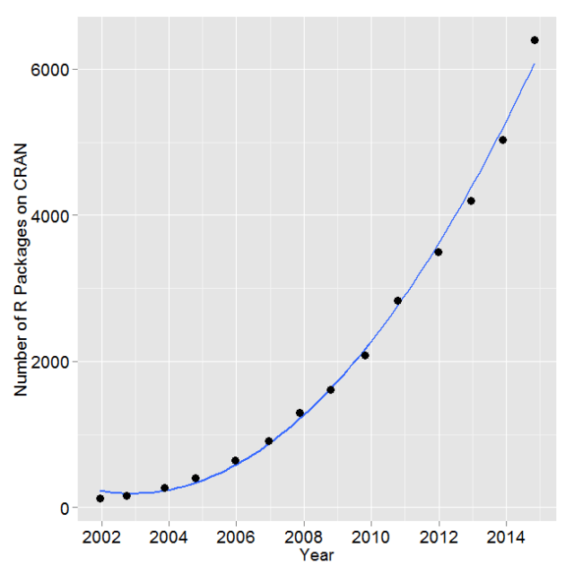
1.1 General introduction
Why ‘R’?
Number of R packages available on its main distribution site for the last version released in each year.
Notes:
Packages equals possibilities!!

Slide 5
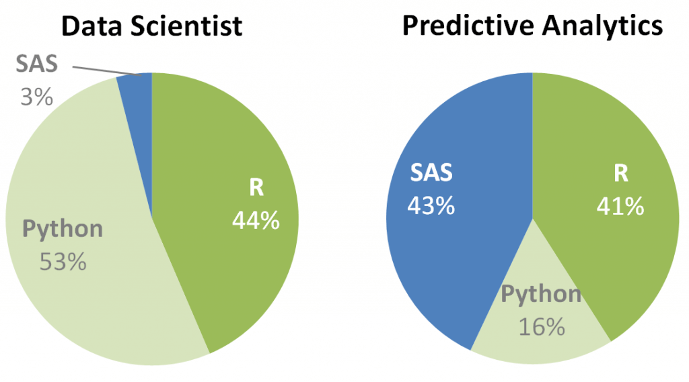
1.1 General introduction
Why ‘R’?
Preferred software

Slide 6

1.1 General introduction
Why ‘R’?
Freeware and open source!
Most used statistical software
Large community of developers (= a lot of support)
(Almost) everything is available (and is extensible)
Programming language
modelling, graphics, GIS, websites, presentations, …
Notes:
Who knows R?

